Slide 1
Algorithms
Quick Sort
Dr. Ashish Sharma
David Luebke <number> 11/08/26

Slide 2
Quicksort
Sorts O(n lg n) in the Average & Best Case
Sorts O(n²) in the worst case
So why would people use it instead of merge sort?
David Luebke <number> 11/08/26

Slide 3
Quicksort
Another divide-and-conquer algorithm
  The array A[p..r] is partitioned into two non-empty subarrays A[p..q] and A[q+1..r]
    Invariant: All elements in A[p..q] are less than all elements in A[q+1..r]
  The subarrays are recursively sorted by calls to quicksort
  Unlike merge sort, no combining step: two subarrays form an already-sorted array
David Luebke <number> 11/08/26

Slide 4
Quicksort Code
Quicksort(A, p, r)
{
if (p < r)
{
q = Partition(A, p, r);
Quicksort(A, p, q);
Quicksort(A, q+1, r);
}
}
David Luebke <number> 11/08/26

Slide 5
Partitioning the Array
Alg. PARTITION (A, p, r)
x ← A[p]
i ← p – 1
j ← r + 1
while TRUE
do repeat j ← j – 1
until A[j] ≤ x
repeat i ← i + 1
until A[i] ≥ x
if i < j
then exchange A[i] ↔ A[j]
else return j
p
r
A:
5
3
2
6
4
1
3
7
i
j
A[p…q]
≤
A[q+1…r]
A:
a_{p}
a_{r}
j=q
i

Slide 6
Example
A[p…r]
5
3
2
6
4
1
3
7
5
3
2
6
4
1
3
7
i
j
i
j
3
3
2
6
4
1
5
7
3
3
2
6
4
1
5
7
i
j
i
j
A[p…q]
A[q+1…r]
3
3
2
1
4
6
5
7
3
3
2
1
4
6
5
7
i
j
j
i
CS 477/677 - Lecture 5

Slide 7
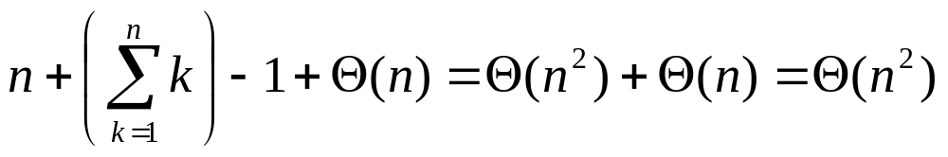
Performance of Quicksort
Worst-case partitioning
  One region has one element and one has n – 1 elements
  Maximally unbalanced
Recurrence
  T(n) = T(n – 1) + Θ(n),
  T(1) = Θ(1)
  T(n) = T(n – 1) + Θ(n)
  =
n
n
1
n - 1
n
1
n - 2
n - 1
n
1
n - 3
n - 2
1
2
3
1
1
2
Θ(n²)
CS 477/677 - Lecture 5

Slide 8
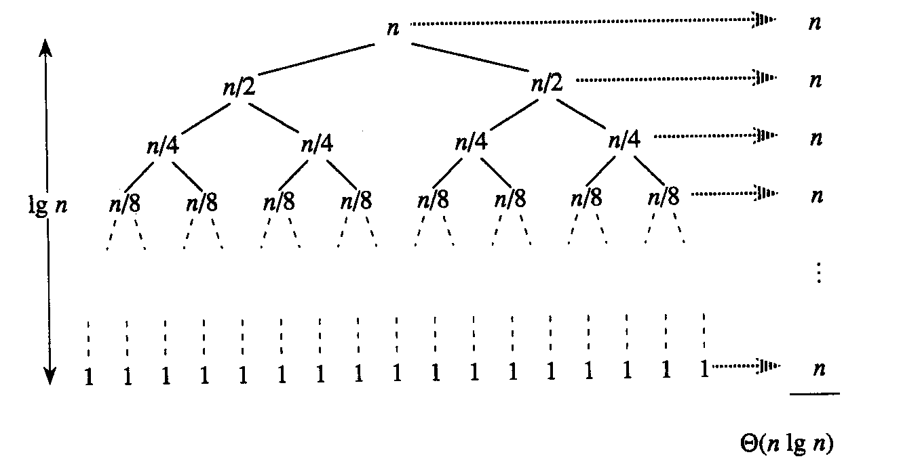
Performance of Quicksort
Best-case partitioning
  Partitioning produces two regions of size n/2
Recurrence
  T(n) = 2T(n/2) + Θ(n)
  T(n) = Θ(nlgn) (Master theorem)
CS 477/677 - Lecture 5

Slide 9
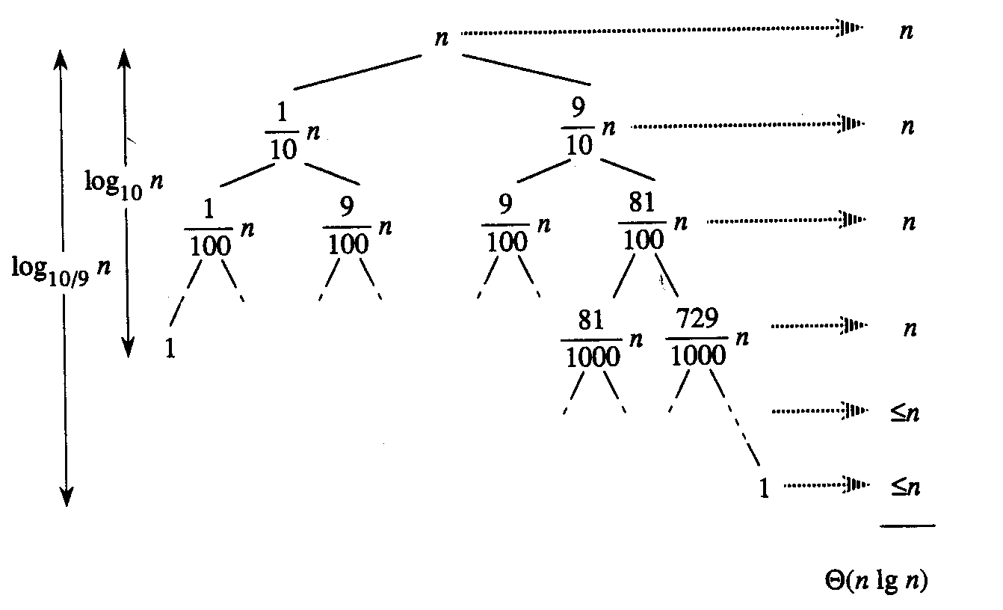
Performance of Quicksort
Balanced partitioning
  Average case closer to best case than worst case
  Partitioning always produces a constant split
E.g.:9-to-1 proportional split
T(n) = T(9n/10) + T(n/10) + n

Slide 10
Performance of Quicksort
Average case
  All permutations of the input numbers are equally likely
  On a random input array, we will have a mix of well balanced and unbalanced splits
  Good and bad splits are randomly distributed across throughout the tree
n
combined cost:
2n-1 = Θ(n)
n
combined cost:
n = Θ(n)
1
n - 1
(n – 1)/2 + 1
(n – 1)/2
(n – 1)/2
(n – 1)/2
Alternate of a good
and a bad split
Nearly well
balanced split
Running time of Quicksort when levels alternate between good and bad splits is O(nlgn)

